Slide 1

A Hands-on Introduction to Machine Learning
3. Cloud Computing

Slide 2
What is cloud computing?
On-demand, remotely accessible computing resources
Shared, virtual machines that can match variable demands with pay-as-you-go structure
Most popular:
Google Cloud Platform (GCP)
Microsoft Azure
Amazon Web Services (AWS)

Slide 3
Google Cloud Platform (GCP)
GCP is a suite of cloud computing services that runs on the same infrastructure that Google
Uses internally for its end-user products like Google Search, Gmail, file storage, and YouTube.
It provides a range of services including computing engine, cloud storage, data analytics, machine learning, and more.
It's designed to help organizations build and run applications on the web.

Slide 4
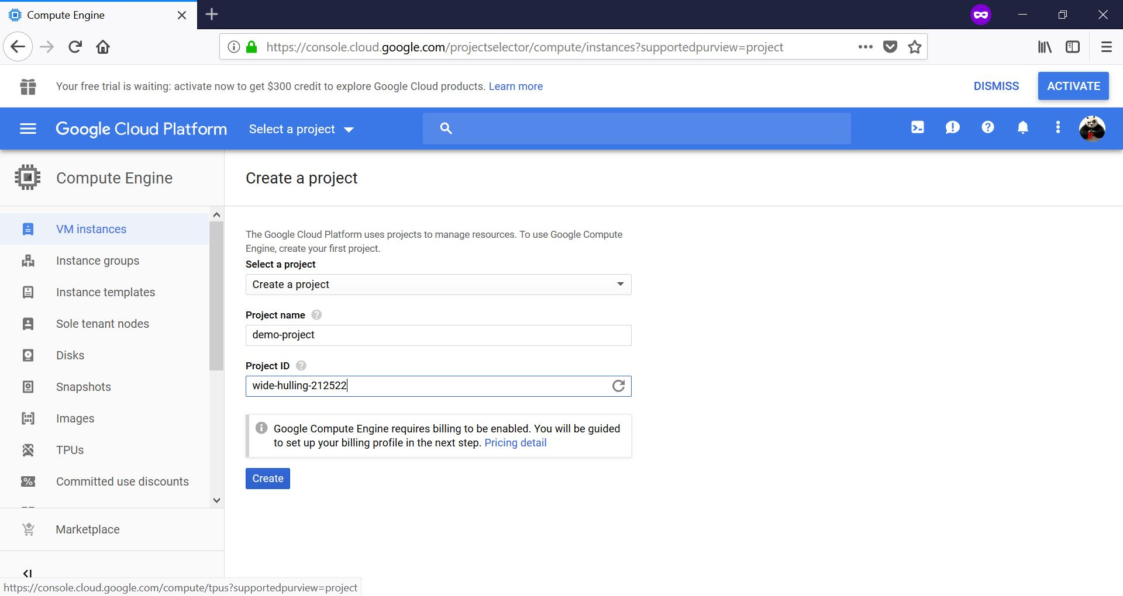
Google Cloud Platform (GCP)

Slide 5
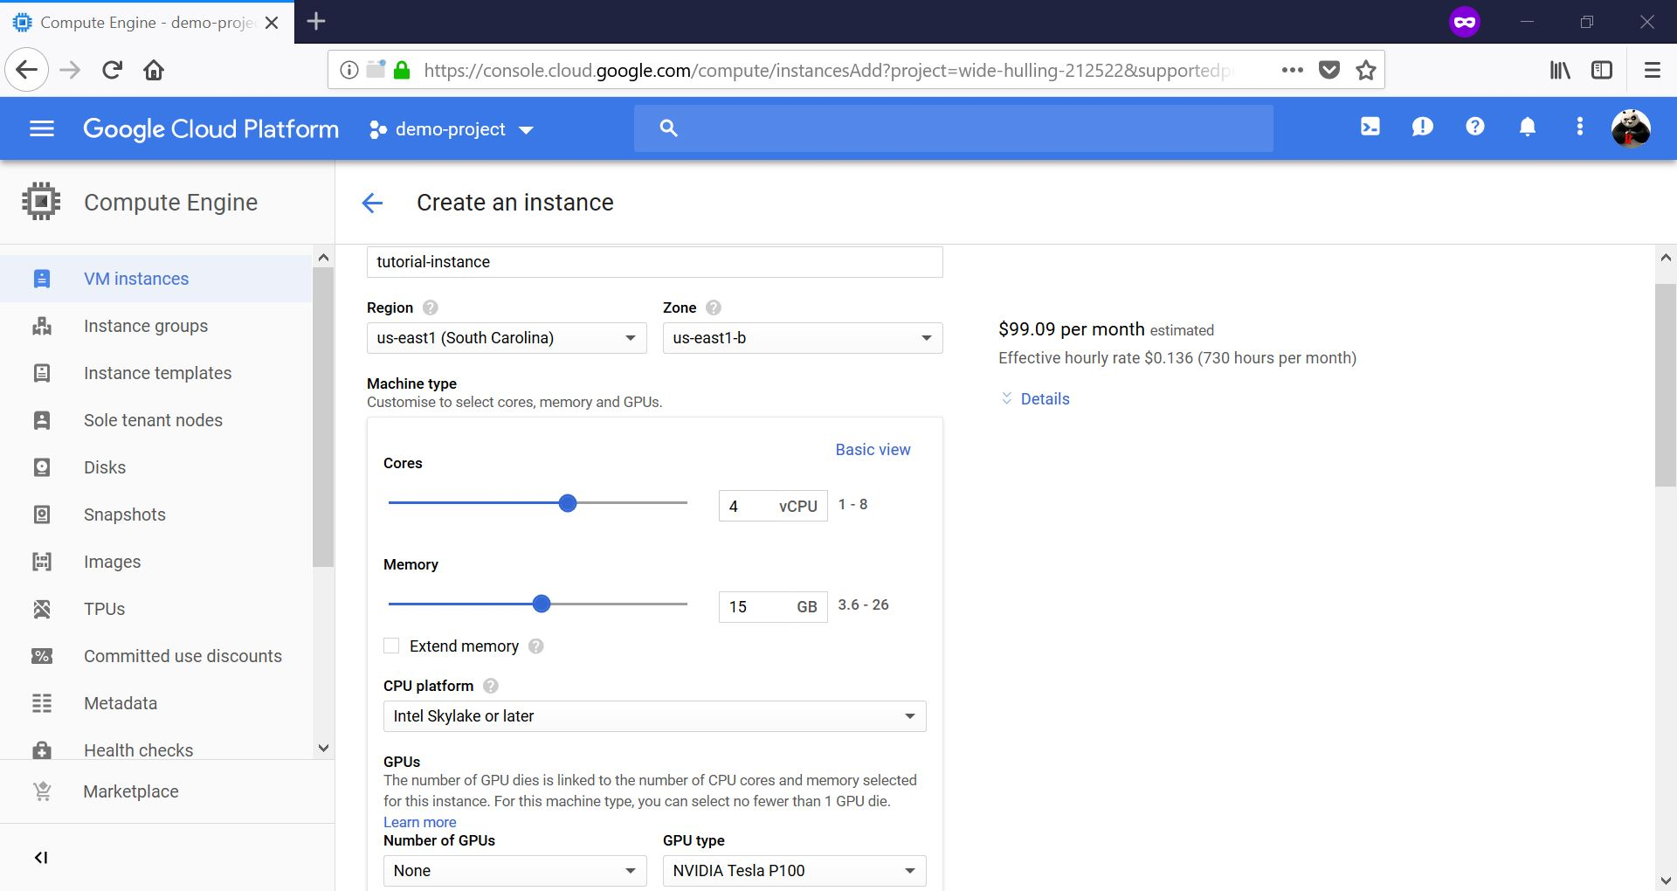
Google Cloud Platform (GCP)

Slide 6
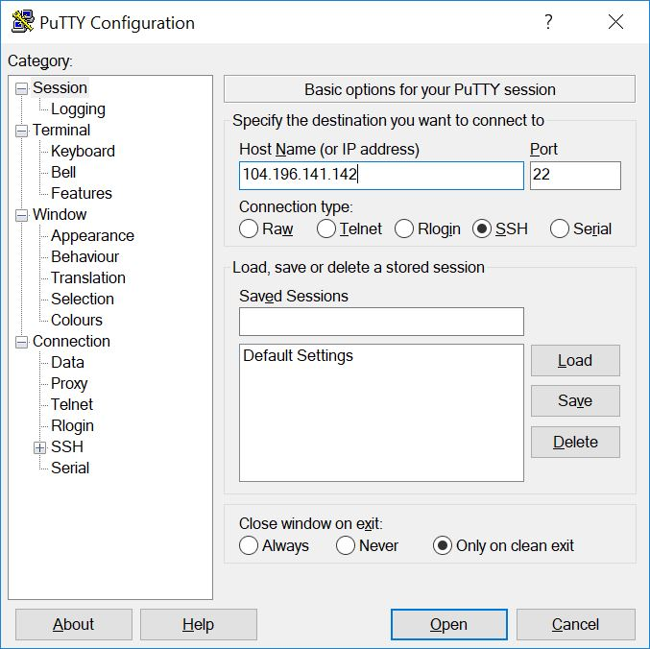
Google Cloud Platform (GCP)

Slide 7
Google Colab
It is a free cloud service provided by Google that allows anyone to write and execute arbitrary Python code through the browser.
It is especially well suited for machine learning, data analysis, and education.
Colab comes with pre-installed libraries and frameworks, such as TensorFlow, PyTorch, and OpenCV, allowing users to get started with machine learning projects without any setup.
Colab notebooks are essentially Jupyter notebooks hosted on Google's servers, which also provide free access to computing resources including GPUs and TPUs, making it a very accessible platform for data scientists and researchers to collaborate and share their work with others.

Slide 8
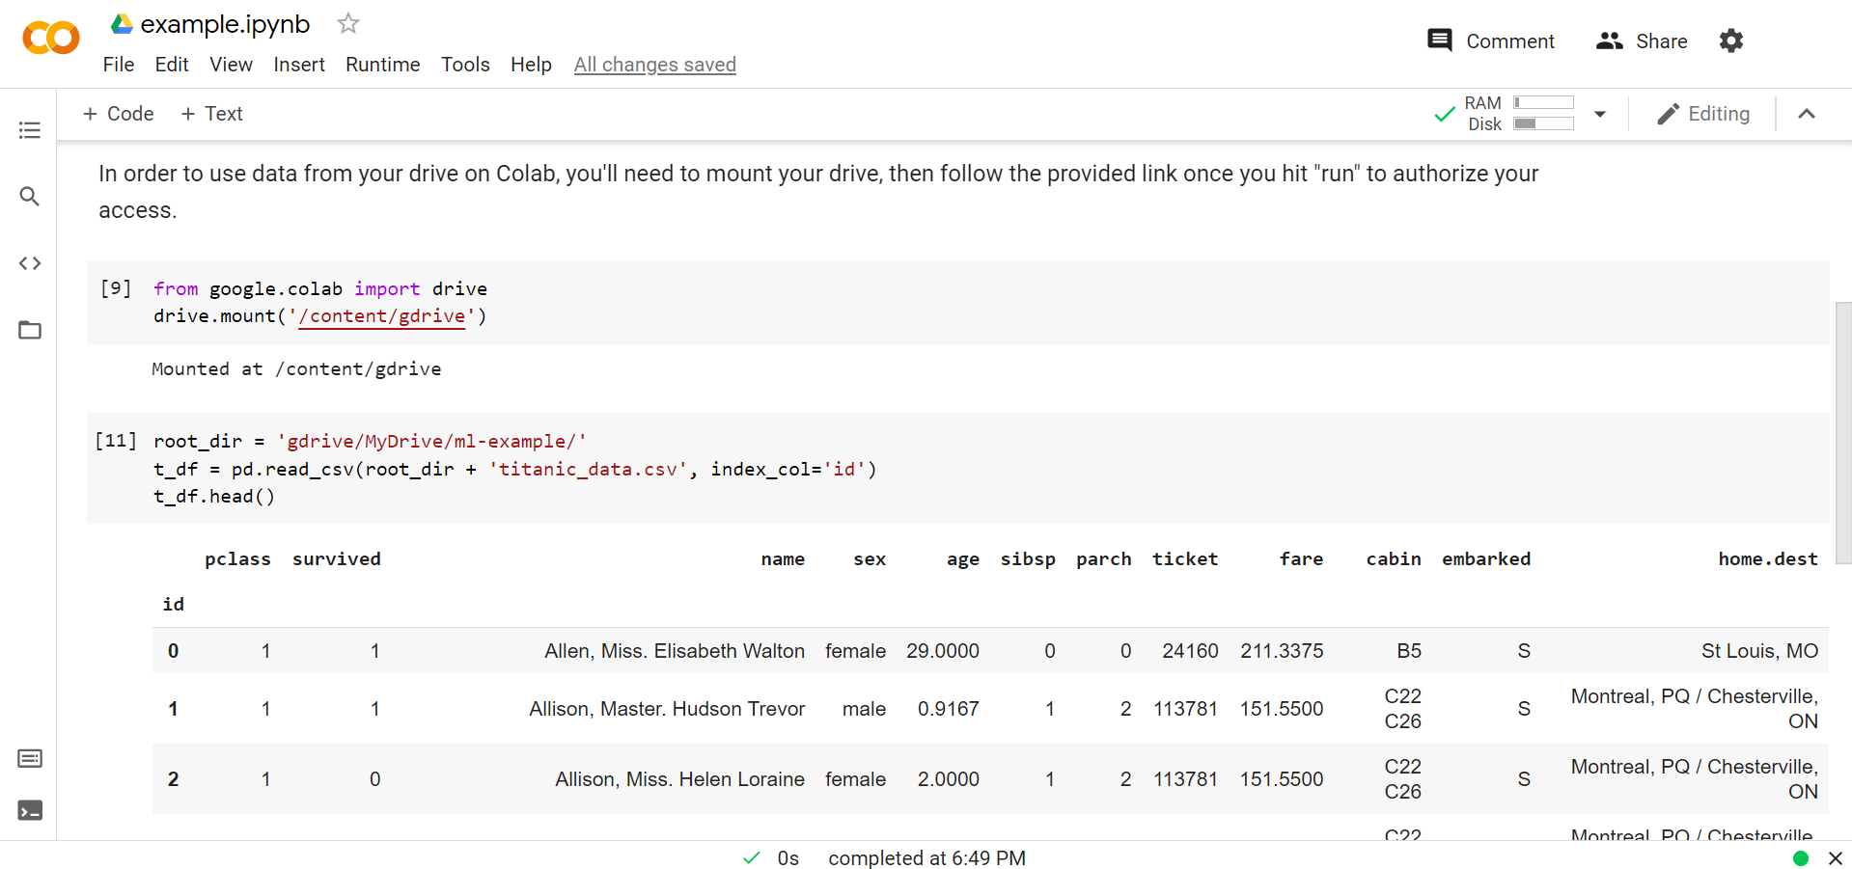
Google Col(l)ab(oratory)

Slide 9
Apache Hadoop
Hadoop is a framework for distributed storage and processing of big data:
Distributed Filesystem (HDFS) is Hadoop's storage system that holds large amounts of data and provides high-throughput access to this information.
MapReduce is a programming model within Hadoop for processing large data sets with a parallel, distributed algorithm on a cluster.
Hadoop Common are the common utilities that support the other Hadoop modules.
YARN (Yet Another Resource Negotiator) is the cluster management technology in Hadoop, which allows for data processing resources to be allocated and managed.

Slide 10
Microsoft Azure
It is Microsoft's public cloud computing platform.
It offers a range of cloud services, including those for computing, analytics, storage, and networking.
Users can pick and choose from these services to develop and scale new applications, or run existing applications, in the public cloud.

Slide 11
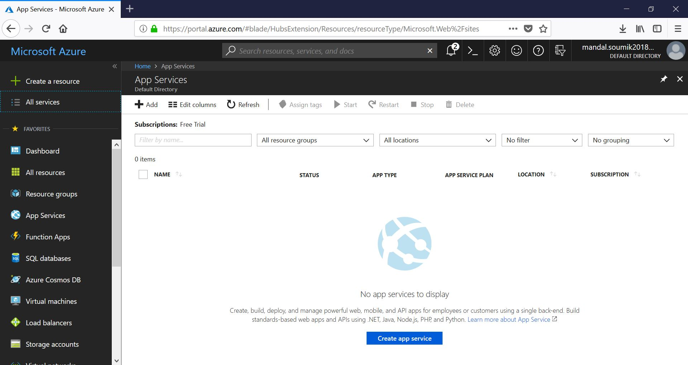
Microsoft Azure

Slide 12
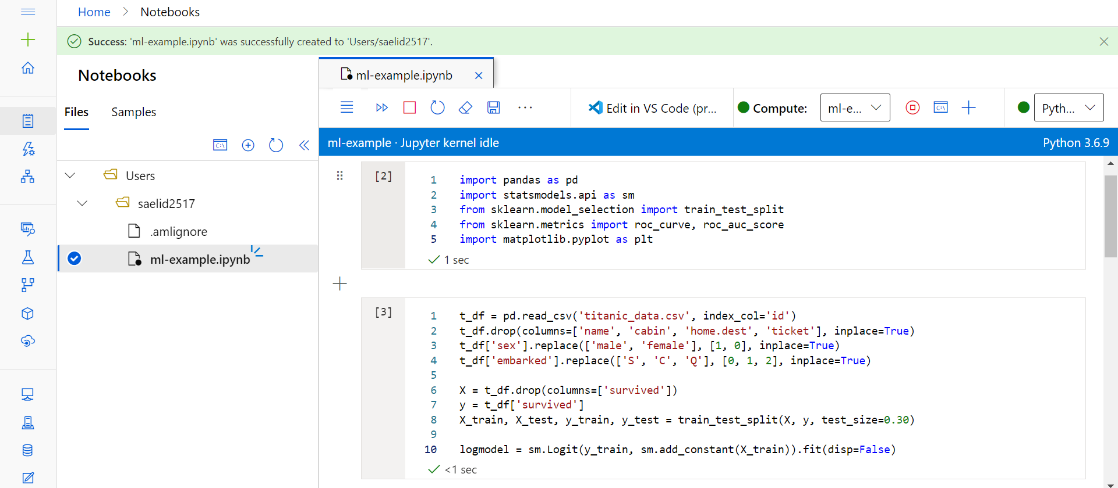
Microsoft Azure

Slide 13
Amazon Web Services (AWS)
AWS is Amazon's comprehensive and broadly adopted cloud platform.
It offers over 200 fully-featured services from data centers globally.
AWS services include infrastructure technologies like compute, storage, and databases, as well as emerging technologies such as machine learning and artificial intelligence, data lakes and analytics, and Internet of Things.
AWS is known for its flexibility, scalability, and wide-ranging set of tools and services.

Slide 14
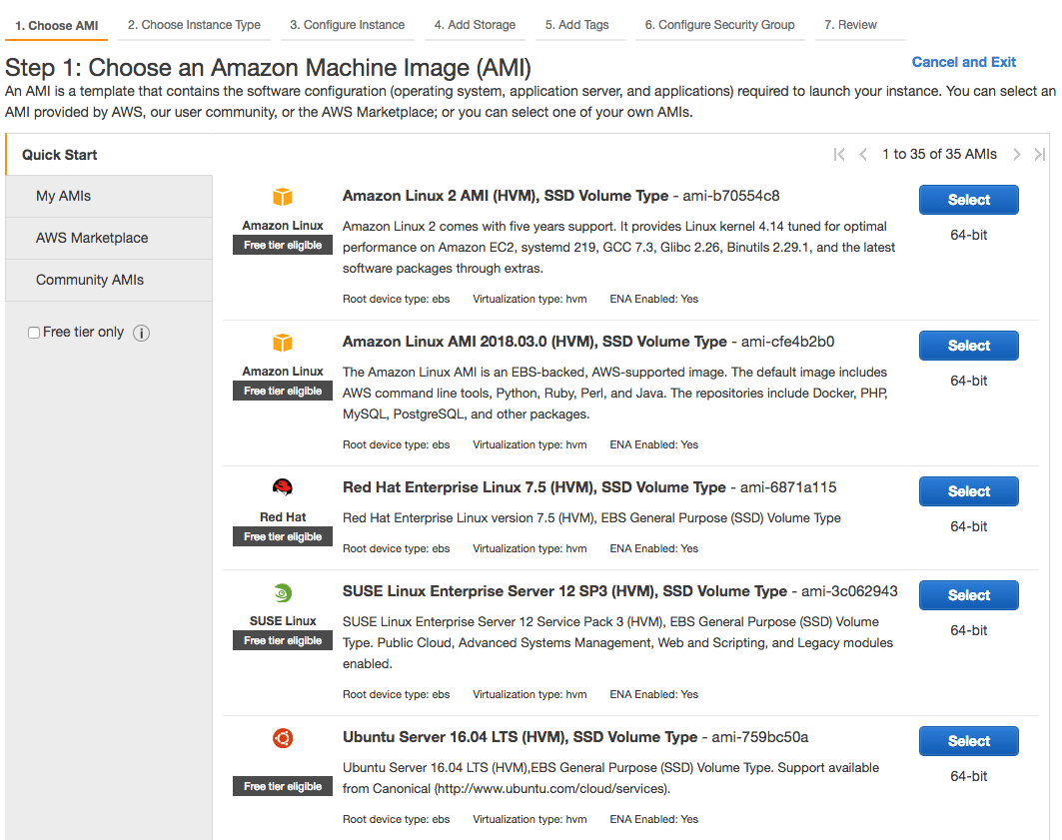
Amazon Web Services (AWS)

Slide 15
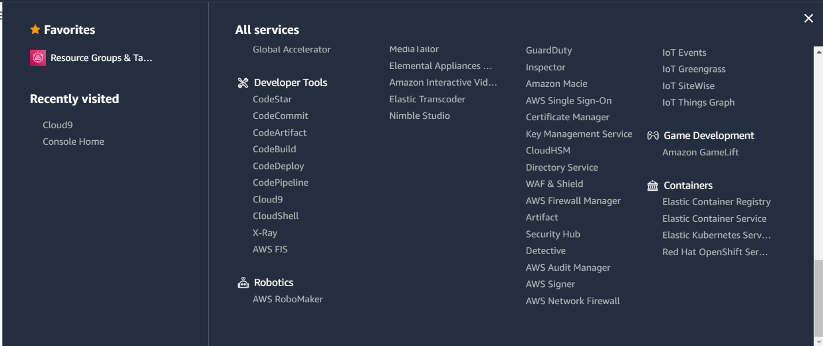
Amazon Web Services (AWS)

Slide 16
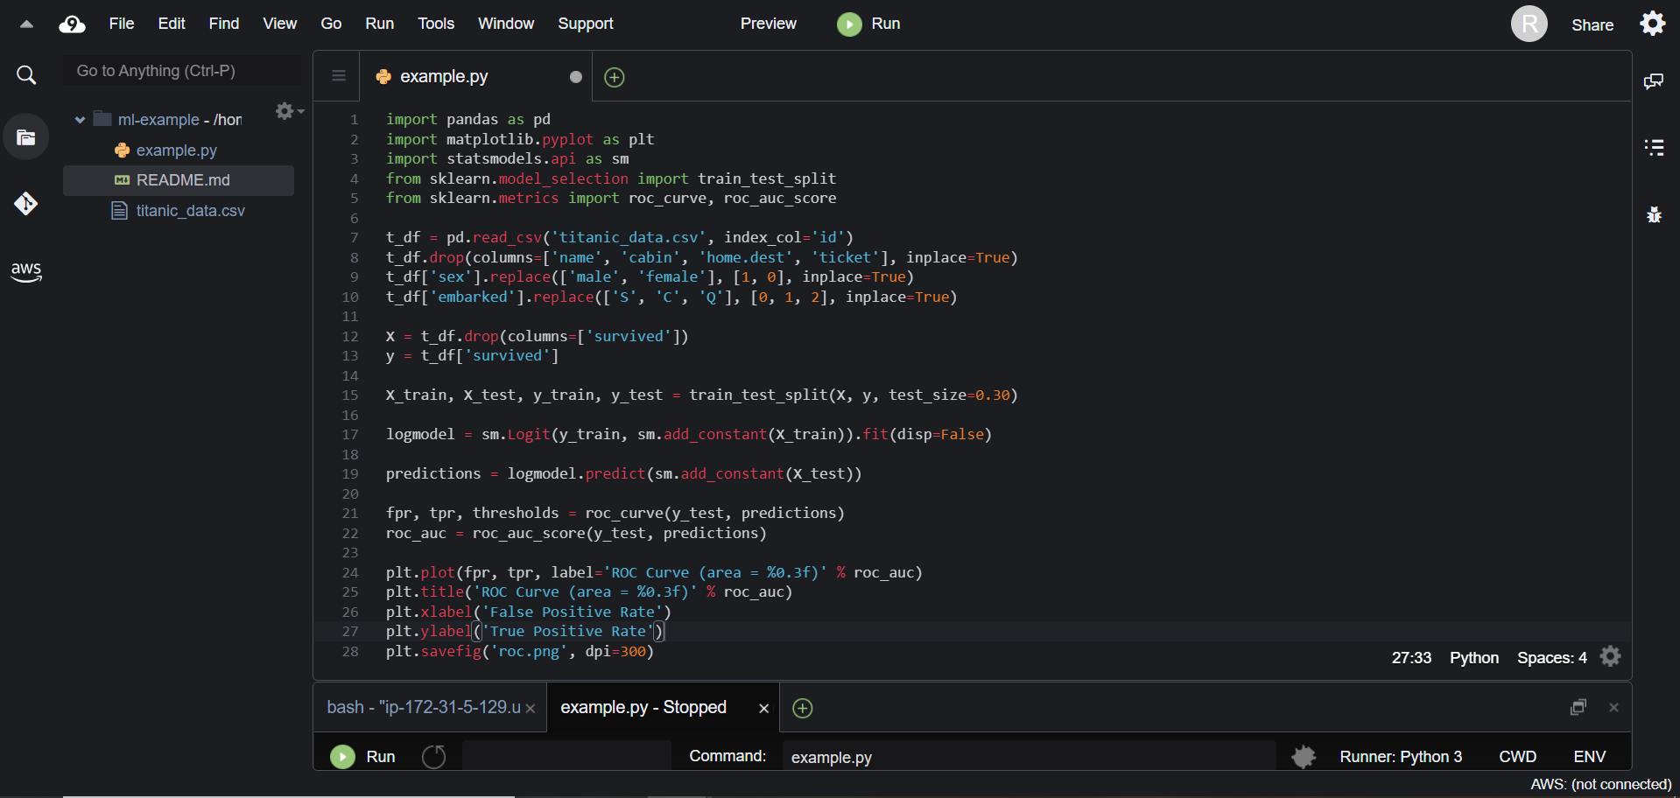
Amazon Web Services (AWS)

Slide 17
Summary
Three major cloud services: Amazon, Google, and Microsoft, but there are several others.
They all have common elements of remote login, compute engine, storage, and other pipelines for development and deployment.
For ML, most of these platforms also offer their custom libraries and solutions.
Competitively, it’s a good idea to have good bit of practice with at least one of them.

